Slide 1
Can mRNA stability be used to predict mRNA localization in neurons?
Marina Chekulaeva

Slide 2

Subcellular localization of mRNAs in neurons
Up to 1 meter long
Soma
Axon
Dendrites

Slide 3
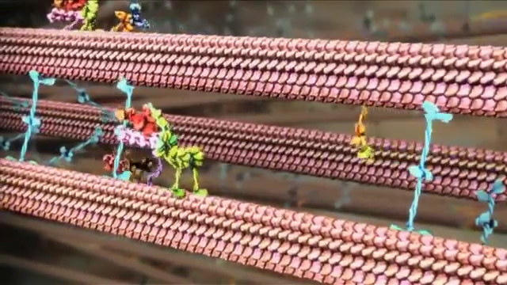
mRNAs are moved by motor proteins

Slide 4
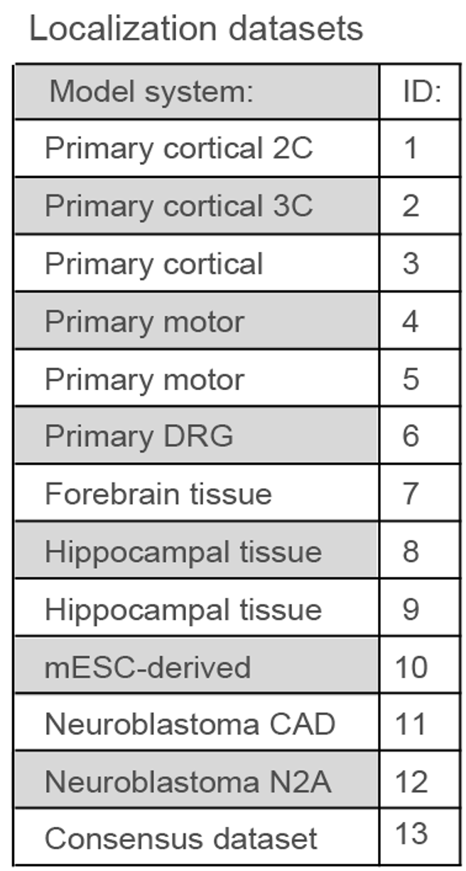
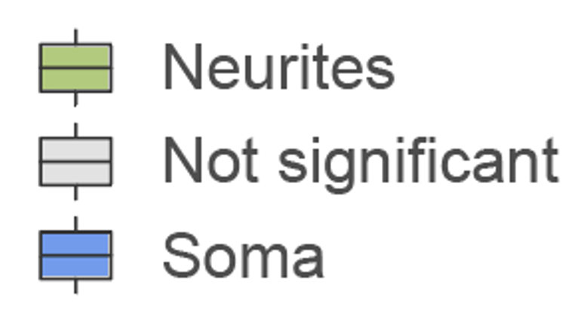
Method to measure mRNA localization in neurons
Neurons
Soma
RNA-seq
mRNAs are classified as:
Axons
Microporous membrane

Slide 5
mRNA stability is measured with a value called mRNA half-life (HL)
The mRNA half-life:
The mRNA half-life is the time required for the concentration of a specific mRNA molecule in a cell to decrease by half due to degradation processes. Simplified: values showing how long an mRNA molecule lives in cells before it’s degraded, measured in hours.

Slide 6
Types of elements that regulate mRNA stability analyzed in this study
RNA Motifs:
RNA motifs are specific patterns or sequences in RNA that have particular functions. Think of them as “codes” within the RNA that tell the cell to do something special, e.g. to interact with other molecules.
Here I analyze one type of motifs – ARE

Slide 7
Types of elements that regulate mRNA stability analyzed in this study
m6A:
m6A (N6-methyladenosine) is a chemical modification that can be added to RNA. It’s like a small “tag” or “mark” on certain adenine bases (A) in the RNA. This tag helps the cell control how the RNA is processed, how long it lasts, and when and where it’s used to make proteins. It’s one way the cell fine-tunes gene expression.

Slide 8
Types of elements that regulate mRNA stability analyzed in this study
Codon Optimality (tAI):
Codon optimality refers to how efficiently a cell reads specific codons in the RNA to make proteins. Codons are 3-letter sequences that tell the cell which amino acid to add to a protein. Some codons are read faster and more accurately than others, making them “optimal” because they help the protein be made more efficiently. Codon optimality can influence how quickly and well a protein is produced by the cell.

Slide 9
Types of elements that regulate mRNA stability analyzed in this study
3’UTR length:
The 3’ UTR (short for “3’ untranslated region”) is a part of mRNA that doesn’t directly code for proteins but plays a crucial role in controlling how the gene functions. Longer 3’UTRs tend to contain more destabilizing elements and are associated with lower mRNA stability.

Slide 10
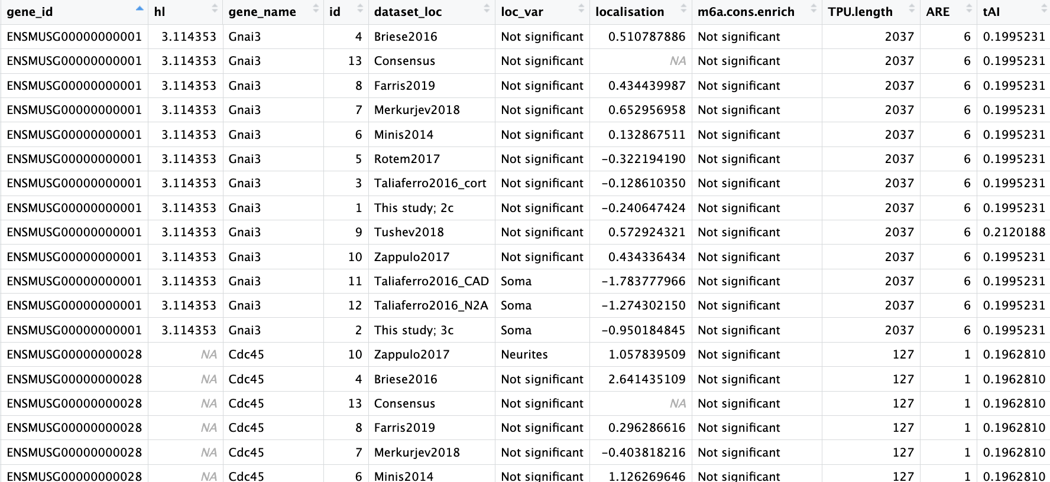
Data:

Slide 11
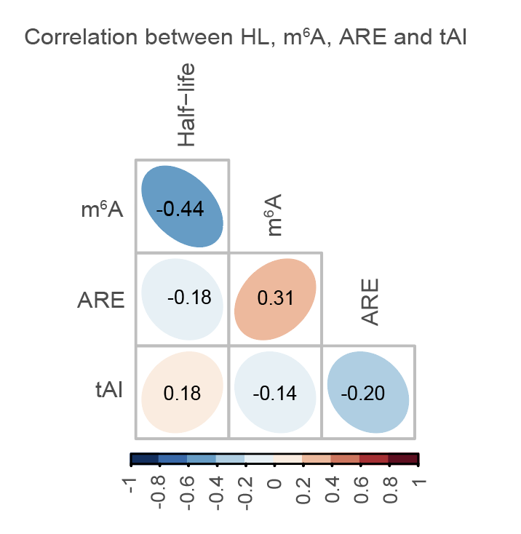
Interplay of multiple destabilizing elements in mRNA localization
Correlation between the presence of multiple types of destabilizing elements in mRNAs. The numbers and color scale represent Pearson correlation coefficients* between the indicated features.
*Pearson correlation coefficient (often symbolized as r) is a statistical measure that describes the strength and direction of a linear relationship between two variables.
# Select the relevant columns: HL, ARE, tAI, and m6a.enrich
variables_to_correlate = table[['HL', 'ARE', 'tAI', 'm6a.enrich']]
# Calculate the Pearson correlation coefficient matrix
correlation_matrix = variables_to_correlate.corr(method='pearson')
11

Slide 12
Can stability be predicted using mRNA features like m6A, 3‘UTR length, number of AREs and tAI?
I used an R package “ranger" (https://github.com/imbs-hl/ranger, Wright and Ziegler, 2017) to predict mRNA half-lives. In phyton, I used “sklearn” package
The dataset was divided randomly into training (70%) and testing (30%) sections. The predictors used for mRNA half-lives were m6A enrichment, 3’UTR length, ARE count in 3’UTR, and codon optimality (tAI).
The resulting model was applied to predict mRNA half-lives in the test dataset, and to determine the R-squared and Pearson correlation coefficient between the predicted and observed values.
*Random forest: machine learning algorithm that combines the power of multiple decision trees to make robust predictions. It operates by building a collection (or “forest”) of many randomly generated decision trees and averaging their outputs for more accurate, reliable predictions.
Advantages:
High Accuracy: By averaging multiple trees, Random Forests reduce the risk of overfitting and can achieve high accuracy.
Feature Importance: The algorithm can rank features by their importance, helping to understand which variables most influence the predictions.
Handles Missing Data: Random Forests can handle missing values well, often providing reasonable predictions even with incomplete data.

Slide 13
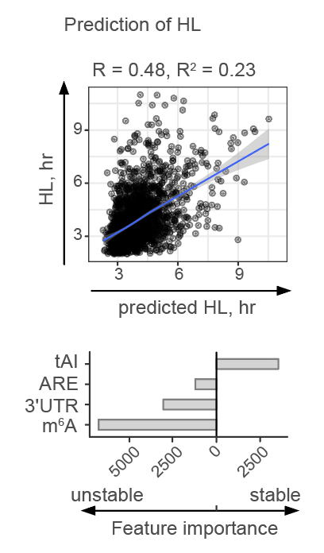
Can stability be predicted using mRNA features like m6A, 3‘UTR length, number of AREs and tAI?
Scatterplot shows correlation of actual (Y) and predicted (X) half-lives
Barplot below the scatterplot indicates importance of indicated parameters (Y).
Notes:
How to deduce the sign of features: positive or negative? Aris advice: look at sharp values (cited in the course)

Slide 14
Can mRNA localization be predicted using mRNA stability features?
I utilized an R package called "ranger" (https://github.com/imbs-hl/ranger, Wright and Ziegler, 2017) to predict mRNA localization.
The dataset was divided randomly into training (70%) and testing (30%) sections. The predictors used for mRNA half-lives were mRNA half-lives (HL), m6A enrichment, 3’UTR length, ARE count in 3’UTR, and codon optimality (tAI).
The resulting model was applied to predict mRNA localization in the test dataset, and to determine the R-squared and Pearson correlation coefficient between the predicted and observed values.
*Pearson correlation coefficient (often symbolized as r) is a statistical measure that describes the strength and direction of a linear relationship between two variables.
*R-squared is a statistical measure used to assess how well a model fits the data. It represents the proportion of the variance in the dependent variable that is predictable from the independent variables.

Slide 15
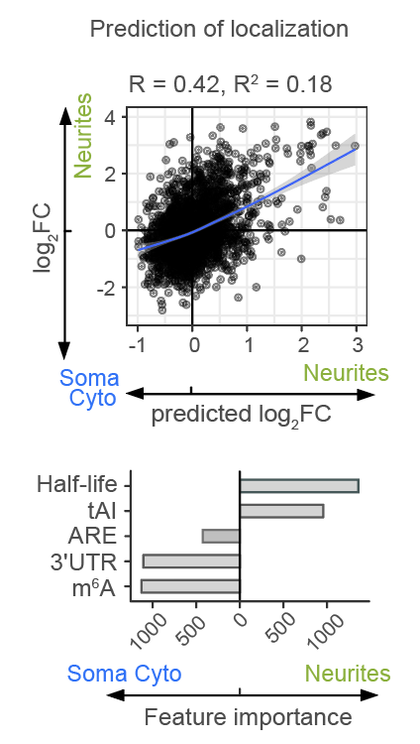
Can localization be predicted using mRNA stability features?
Scatterplot shows correlation of actual (Y) and predicted (X) mRNA localization (log2 fold change Neurites vs. Soma)
Barplot below the scatterplot indicates importance of indicated parameters (Y).

Slide 16
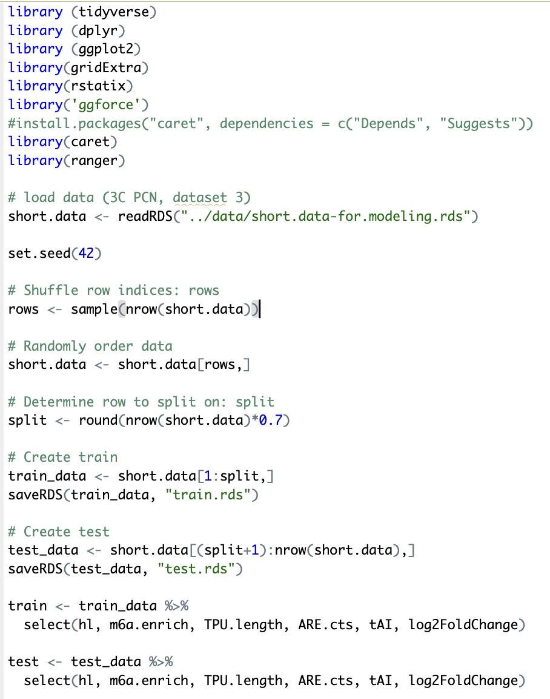
Random forest modeling code: loading and splitting data

Slide 17
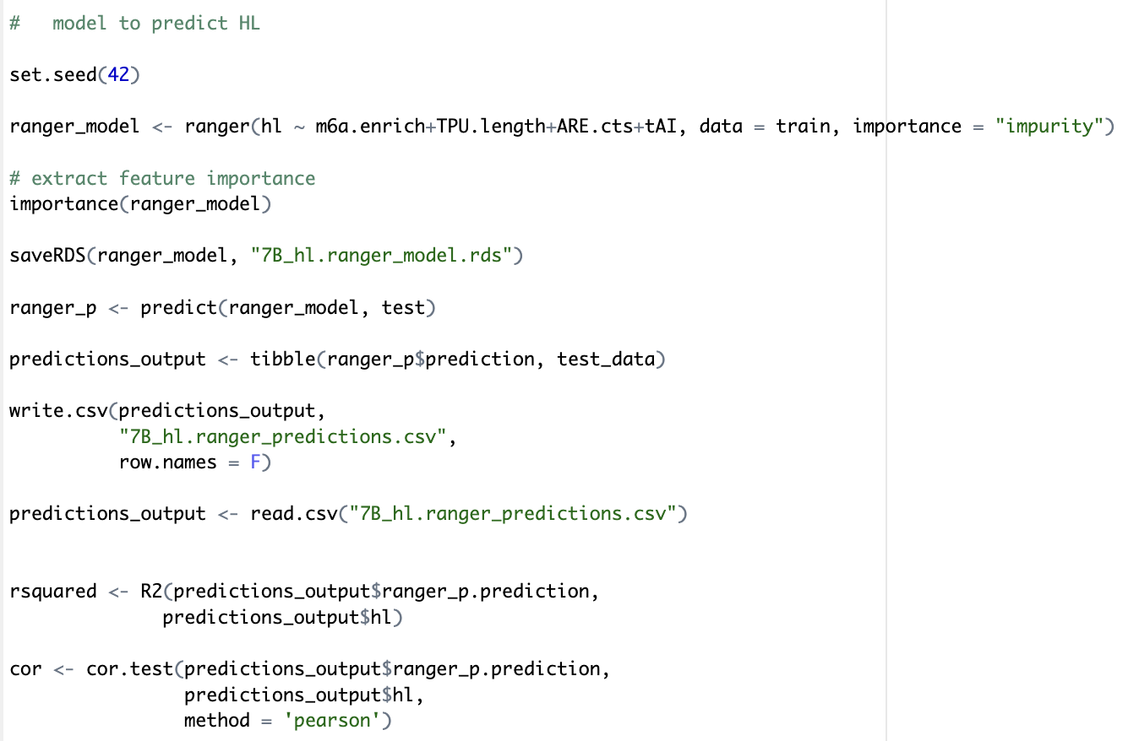
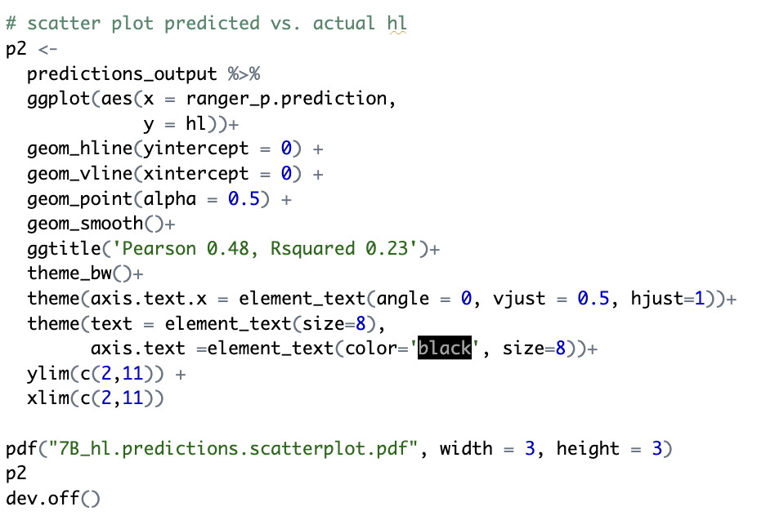
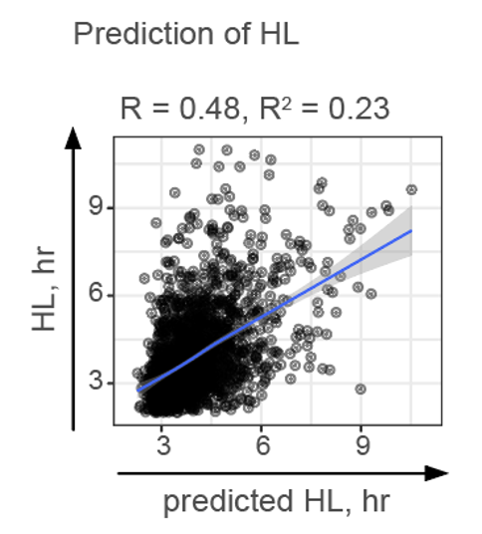
Random forest modeling code: building model for HL & plotting predicted vs. actual HL
setting importance = "impurity" means that feature importance is calculated using a method based on Gini impurity (for classification) or variance reduction (for regression).

Slide 18
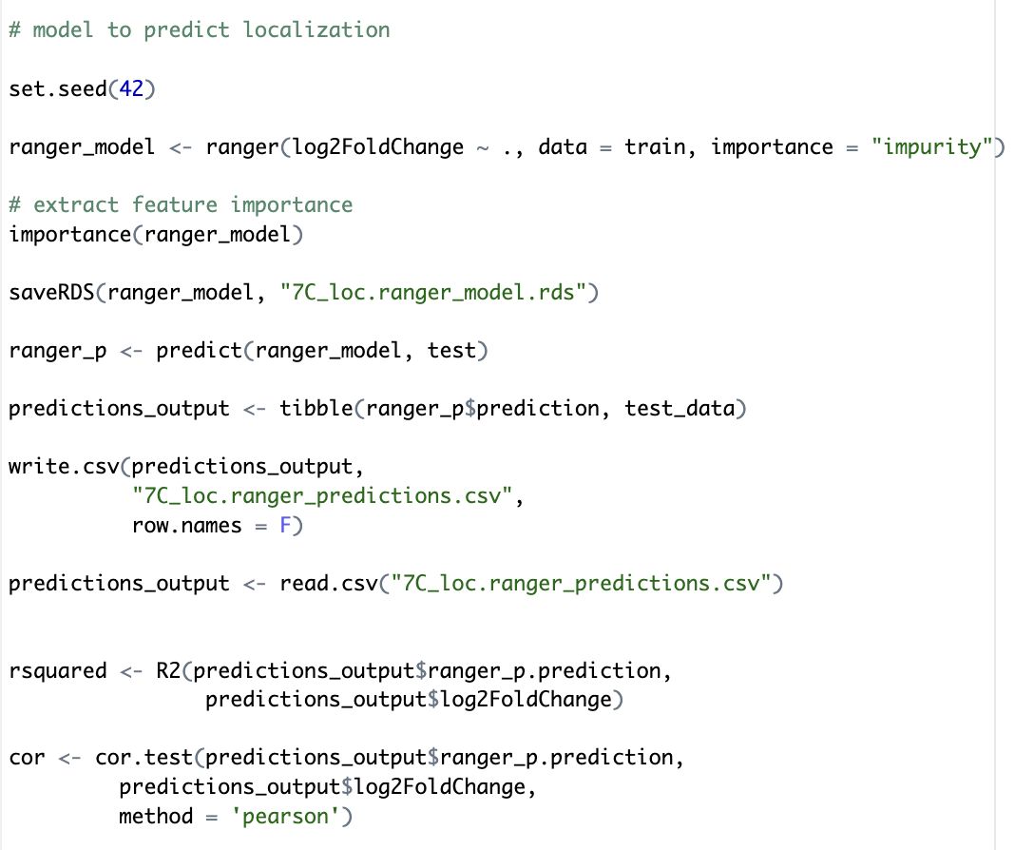
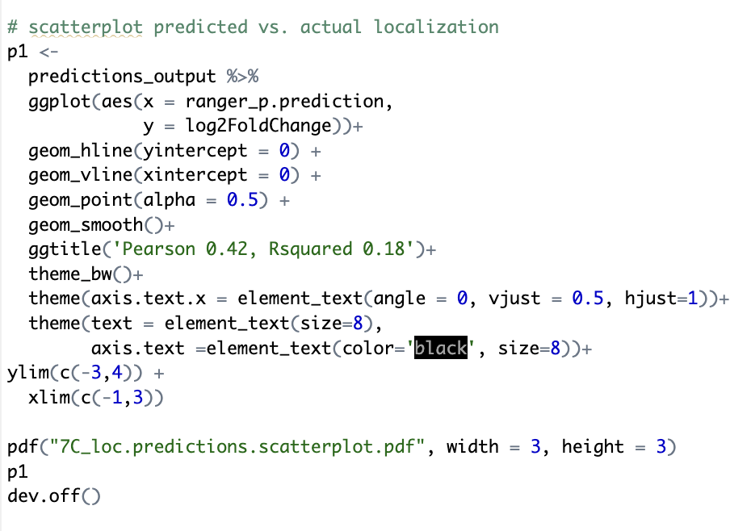
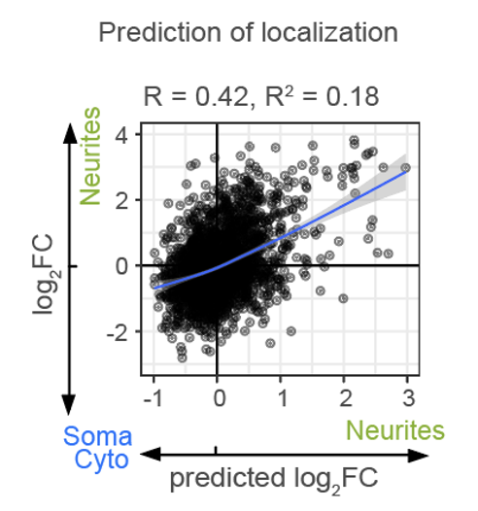
Random forest modeling code: building model for localization & plotting predicted vs. actual localization

Slide 19
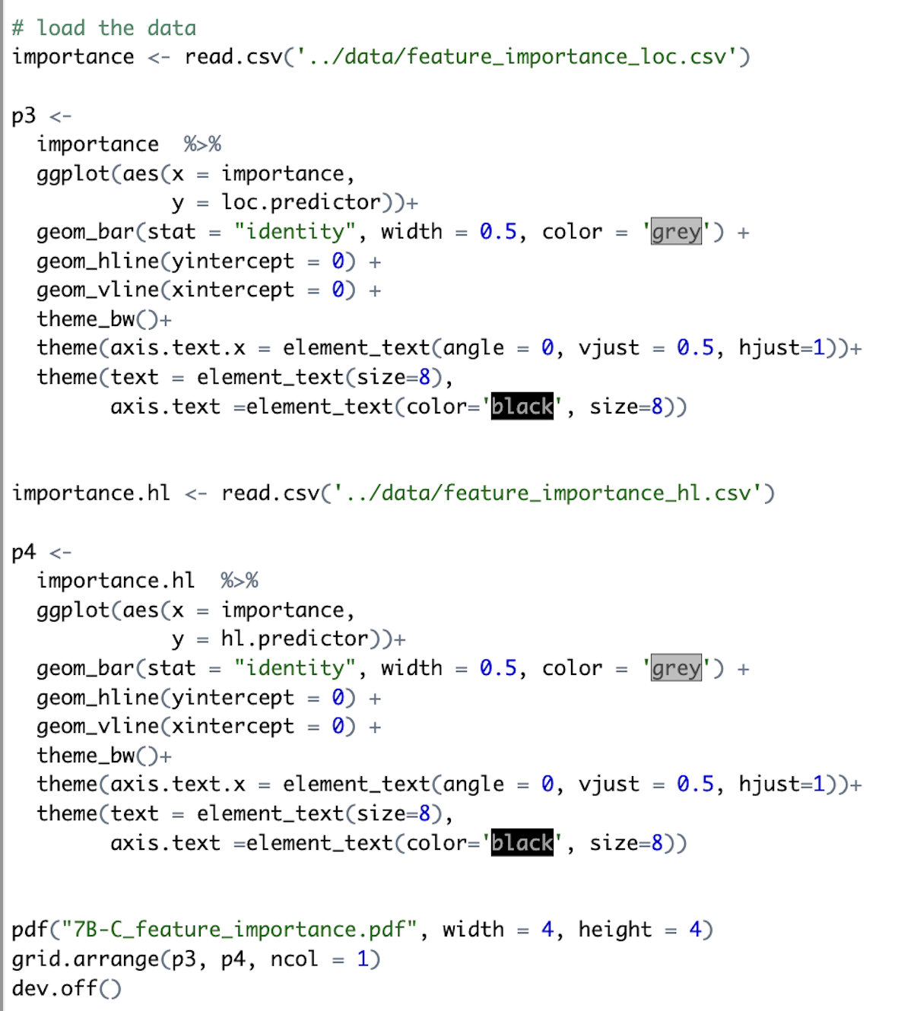
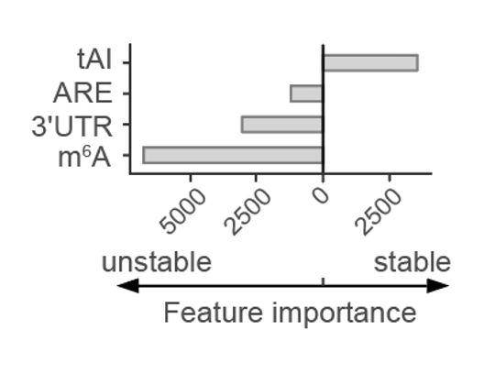
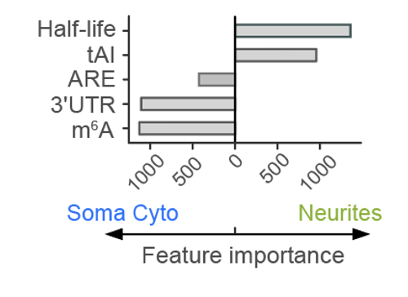
Random forest modeling code: plotting feature importance

Slide 20
The same in phyton
import pandas as pd
import numpy as np
import matplotlib.pyplot as plt
import seaborn as sns
from sklearn.model_selection import train_test_split
from sklearn.ensemble import RandomForestRegressor
from sklearn.metrics import r2_score, mean_squared_error
from joblib import dump, load
# Load data
short_data = pd.read_pickle("../data/short.data-for.modeling.pkl")
# Set seed and shuffle data
np.random.seed(42)
short_data = short_data.sample(frac=1).reset_index(drop=True)
# Split data into train and test sets
split_ratio = 0.7
split_index = int(len(short_data) * split_ratio)
train_data, test_data = short_data[:split_index], short_data[split_index:]
# Save train and test sets
train_data.to_pickle("train.pkl")
test_data.to_pickle("test.pkl")
# Select features for training and testing
train = train_data[['hl', 'm6a.enrich', 'TPU.length', 'ARE.cts', 'tAI', 'log2FoldChange']]
test = test_data[['hl', 'm6a.enrich', 'TPU.length', 'ARE.cts', 'tAI', 'log2FoldChange']]
# Model to predict localization
X_train_loc = train.drop(columns=['log2FoldChange'])
y_train_loc = train['log2FoldChange']
X_test_loc = test.drop(columns=['log2FoldChange'])
y_test_loc = test['log2FoldChange']
rf_loc_model = RandomForestRegressor(random_state=42)
rf_loc_model.fit(X_train_loc, y_train_loc)
# Save the model
dump(rf_loc_model, "7C_loc.rf_model.joblib")
# Predict and evaluate
y_pred_loc = rf_loc_model.predict(X_test_loc)
predictions_output_loc = pd.DataFrame({'predictions': y_pred_loc, 'actual': y_test_loc})
predictions_output_loc.to_csv("7C_loc.rf_predictions.csv", index=False)
# R-squared and correlation
rsquared_loc = r2_score(y_test_loc, y_pred_loc)
correlation_loc = np.corrcoef(y_pred_loc, y_test_loc)[0, 1]
# Scatter plot of predicted vs. actual localization
plt.figure(figsize=(3, 3))
sns.scatterplot(x=y_pred_loc, y=y_test_loc, alpha=0.5)
sns.lineplot(x=[y_test_loc.min(), y_test_loc.max()], y=[y_test_loc.min(), y_test_loc.max()], color="red")
plt.title(f'Pearson: {correlation_loc:.2f}, R-squared: {rsquared_loc:.2f}')
plt.xlabel('Predicted Localization')
plt.ylabel('Actual Localization')
plt.xlim(-1, 3)
plt.ylim(-3, 4)
plt.savefig("7C_loc.predictions.scatterplot.pdf")
# Model to predict HL
X_train_hl = train[['m6a.enrich', 'TPU.length', 'ARE.cts', 'tAI']]
y_train_hl = train['hl']
X_test_hl = test[['m6a.enrich', 'TPU.length', 'ARE.cts', 'tAI']]
y_test_hl = test['hl']
rf_hl_model = RandomForestRegressor(random_state=42)
rf_hl_model.fit(X_train_hl, y_train_hl)
# Save the model
dump(rf_hl_model, "7B_hl.rf_model.joblib")
# Predict and evaluate
y_pred_hl = rf_hl_model.predict(X_test_hl)
predictions_output_hl = pd.DataFrame({'predictions': y_pred_hl, 'actual': y_test_hl})
predictions_output_hl.to_csv("7B_hl.rf_predictions.csv", index=False)
# R-squared and correlation
rsquared_hl = r2_score(y_test_hl, y_pred_hl)
correlation_hl = np.corrcoef(y_pred_hl, y_test_hl)[0, 1]
# Scatter plot of predicted vs. actual HL
plt.figure(figsize=(3, 3))
sns.scatterplot(x=y_pred_hl, y=y_test_hl, alpha=0.5)
sns.lineplot(x=[y_test_hl.min(), y_test_hl.max()], y=[y_test_hl.min(), y_test_hl.max()], color="red")
plt.title(f'Pearson: {correlation_hl:.2f}, R-squared: {rsquared_hl:.2f}')
plt.xlabel('Predicted HL')
plt.ylabel('Actual HL')
plt.xlim(2, 11)
plt.ylim(2, 11)
plt.savefig("7B_hl.predictions.scatterplot.pdf")
# Plotting feature importance for localization and HL models
importance_loc = pd.DataFrame({
'feature': X_train_loc.columns,
'importance': rf_loc_model.feature_importances_
}).sort_values(by='importance', ascending=False)
importance_hl = pd.DataFrame({
'feature': X_train_hl.columns,
'importance': rf_hl_model.feature_importances_
}).sort_values(by='importance', ascending=False)
fig, (ax1, ax2) = plt.subplots(2, 1, figsize=(4, 4))
# Localization importance
sns.barplot(data=importance_loc, x='importance', y='feature', ax=ax1, color='grey')
ax1.set_title('Feature Importance for Localization')
# HL importance
sns.barplot(data=importance_hl, x='importance', y='feature', ax=ax2, color='grey')
ax2.set_title('Feature Importance for HL')
plt.tight_layout()
plt.savefig("7B-C_feature_importance.pdf")

Slide 21
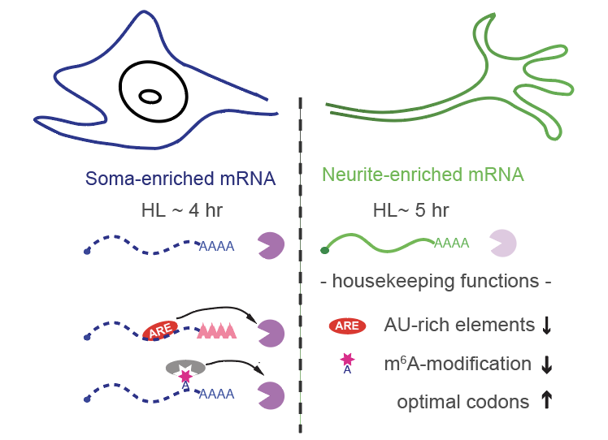
Model: high mRNA stability is predictive of mRNA localization to neurites
Scheme illustrating the role of mRNA stability in mRNA localization in neurons. Neurite-localized mRNAs are on average more stable than soma-localized mRNAs, and mRNA stability in whole neurons can be used as a predictor of mRNA localization.

